Slide 1


Slide 2
End term presentation for
Plant Disease Detection

Slide 3
500069734 R134218123 Pratham Pandey
500068183 R134218125 Pulkit Mittal
500067543 R134218152 Shashwat Chitransh
500068730 R134218206 Karmanya Dadhich
Under the mentorship of
Ms. Shahina Anwarul
Department of Systemics

Slide 4
Introduction
Human society now has the ability to produce enough food to feed more than 7 billion people thanks to modern technologies. However, a number of variables, such as climate change, pollinator decrease, plant diseases, and others, continue to pose a danger to food security. Plant diseases are a global threat to food security and may be devastating for smallholder farmers whose livelihoods are dependent on healthy crops.
To prevent crop loss due to disease, a variety of strategies have been devised. Agricultural extension groups or other institutions, such as local plant clinics are usually involved in disease identification. More recently, similar attempts have been aided by making disease diagnosis information available online, taking advantage of the world's growing Internet access.
In the last few years, computer vision, and specifically object identification, has made great progress. As an example of end-to-end learning, deep neural networks have lately been successfully deployed in a variety of disciplines. Neural networks convert an input—for example, a picture of a diseased plant—to an output—for example, a crop-disease pair. A neural network's nodes are mathematical functions that receive numerical inputs from the incoming edges and output numerical values as an outgoing edge.
We’ll be implementing deep learning to build a model capable of identifying diseases in multiple plants.

Slide 5
Problem Statement
Crop diseases are a huge danger to food security, but due to a lack of infrastructure in many regions of the world, timely detection is challenging. Food losses caused by pathogens such as bacteria, viruses, and fungus infecting crops are a continuous problem. The situation has worsened by the fact that diseases are now more easily transmitted globally than ever before.

Slide 6
Objectives
Comparative analysis of different classifiers for Plant Disease Detection.
Collection and cleaning of dataset of 3 plants with a number of diseases for plant disease classification.
Design a classification model for predicting plant disease accurately.
Evaluation of the proposed model.
Building an interactive web application for the user.

Slide 7
Methodology
The project involves all the steps involved in a typical ML project. They are:
Loading the dataset
Exploratory data analysis
Data pre-processing
Building the model
Compiling the model
Training the model
Using our model to make predictions
We took a dataset having images of leaves of 3 plant namely tomato, potato and bell peppers with a folder for healthy yield and some folders for various diseases found in them, from Kaggle. The dataset consists of fifteen folders comprising of images with healthy and diseased leaves of potato, tomato and bell peppers.
Once the dataset was cleaned and processed, we loaded it and split it into three different folders for training, validation and testing. We used tensorflow.keras module to build our model and train it. Once the model was trained, we passed the testing dataset through it to predict the plant disease and to obtain the accuracy.
We built a web-application that a user will be able to access the feature for enhanced convenience.

Slide 8
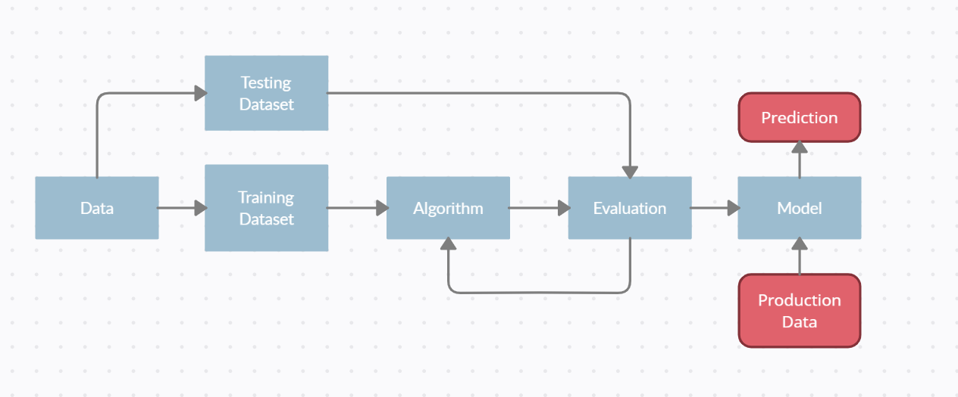
Workflow

Slide 9
Design & Architecture
The project is comprised of multiple components which have been integrated into one to work effectively. The components are as follows:
The dataset is split into training, validation and testing datasets in 8:1:1 ratio using splitfolders.
A piece of code is used to train a model to perform plant disease detection. It includes setting the tuning parameters for training the model, loading the dataset, pre-processing the dataset, applying various augmentations to the training dataset, building, compiling, training and assessing the model. Following modules are used for the same:
os: For joining and handling paths.
tensorflow: For building, compiling and training a sequential model which will be used for making predictions.
OpenCV: For reading images for detection.
matplotlib: For plotting images and graphs.
Scikit-learn: To build a confusion matrix to assess the model.
Numpy: To perform various mathematical operations.

Slide 10
Design & Architecture
Now that we’ve trained the model, we need to use the model to perform predictions. This part is done using python in app.py, which includes different functions to take image as input via upload. The images are handled using opencv. Flask is used to work with the frontend, which is then integrated with HTML pages, styled using CSS and Javascript. Different components of functions have different endpoints which render a certain component according to functionality needed.
The HTML component includes two files namely base.html and index.html. base.html contains a basic template for the frontend which is inherited by index.html. Index.html is rendered upon starting the server and opening the page for the project in a web browser.
CSS is used to beautify the webpage by adding design elements and a beautiful background.
The image request and response are handled using javascript.
A weather api is implemented in javascript to display the current weather of the place.
The website has also been deployed on cloud using herokuapp.

Slide 11
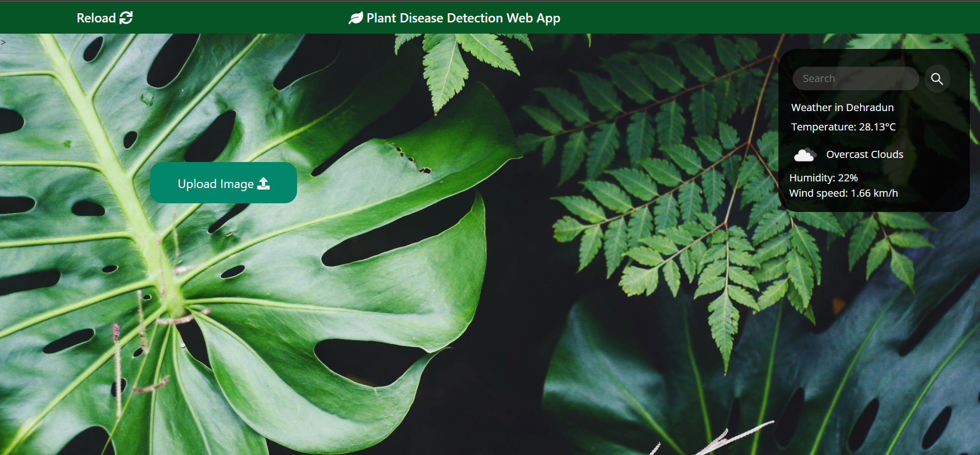
UI

Slide 12
Conclusion
Failure of crops has always been an issue for farmers around the globe, reports of more than 50% of yield lost are frequent. Even if high measures are taken to protect crops some of them are still bound to fail. The threat to food security has only grown in the past 3 decades due to various factors like climate change and use of harsh chemicals on plantation. This problem can be mitigated by creating a system that intelligently detects plant diseases thus ensuring high yield percentage.
In our project we use concepts of Deep learning to build a model that can accurately detect diseases in a number of plants. We were able to obtain an accuracy of around 93.78%.
The dataset contained over 16000 images belonging to 15 classes for three plants.
Dataset used: https://www.kaggle.com/datasets/emmarex/plantdisease
Web App Link: http://detect-plant-disease.herokuapp.com/
Github Link: https://github.com/Pulkit3108/Plant-Disease-Detection

Slide 13
References
[1] Plant diseases and pests detection based on deep learning: a review | Plant Methods | Full Text (biomedcentral.com)
[2] Richard N Strange and Peter R Scott. Plant disease: a threat to global food security. Annual review of phytopathology, 43, 2005.
[3] Yusuke Kawasaki, Hiroyuki Uga, Satoshi Kagiwada, and Hitoshi Iyatomi. Basic study of automated diagnosis of viral plant diseases using convolutional neural networks. In International Symposium on Visual Computing, pages 638–645. Springer, 2015.
[4] Sharada P Mohanty, David P Hughes, and Marcel Salathé. Using deep learning for image-based plant disease detection. Frontiers in plant science, 7:1419, 2016.
[5] Srdjan Sladojevic, Marko Arsenovic, Andras Anderla, Dubravko Culibrk, and Darko Stefanovic. Deep neural networks based recognition of plant diseases by leaf image classification. Computational intelligence and neuroscience, 2016, 2016.
[6] Nigam S, Jain R, Marwaha S, Arora A, Singh K V. 2019. Deep learning for plant disease identification. (In) Proceeding of International Conference on Agricultural Statistics, New Delhi, November 18-21.
[7] Frontiers | Using Deep Learning for Image-Based Plant Disease Detection | Plant Science (frontiersin.org)

Slide 14
THANK YOU

